Slide 1

Overseas Bank
Credit Card Management System
Presented by:
Shaik Karimulla (892871)
Makandar Azeem Khan (892864)
Guvvala Sravani (892355)
Vineela Baddula (892672)

Slide 2
Scope:
Comprehensive report on customer’s monthly and yearly credit card transaction.
Disclose the uncleared dues of the customer who are exceeding card limit.
Categorize the customers based upon their enthusiasm.
Improvise the business performance.

Slide 3
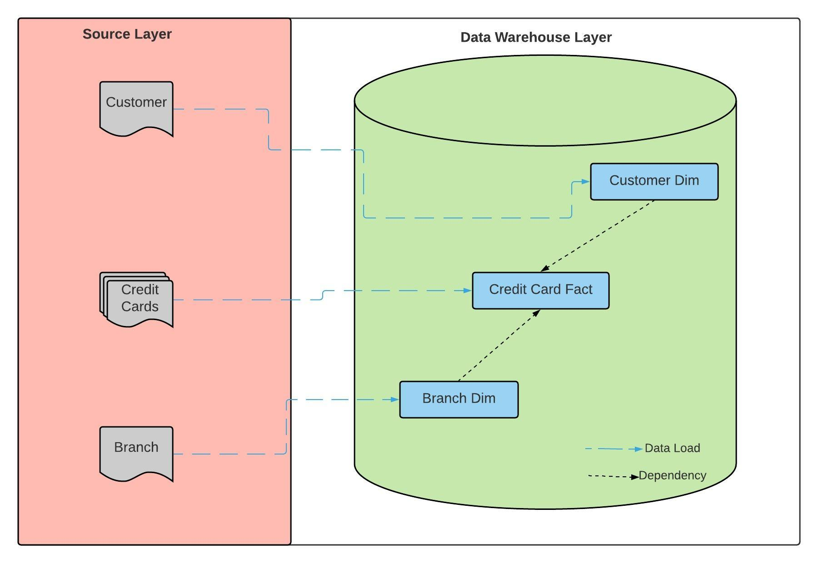
Data Warehouse Structure

Slide 4
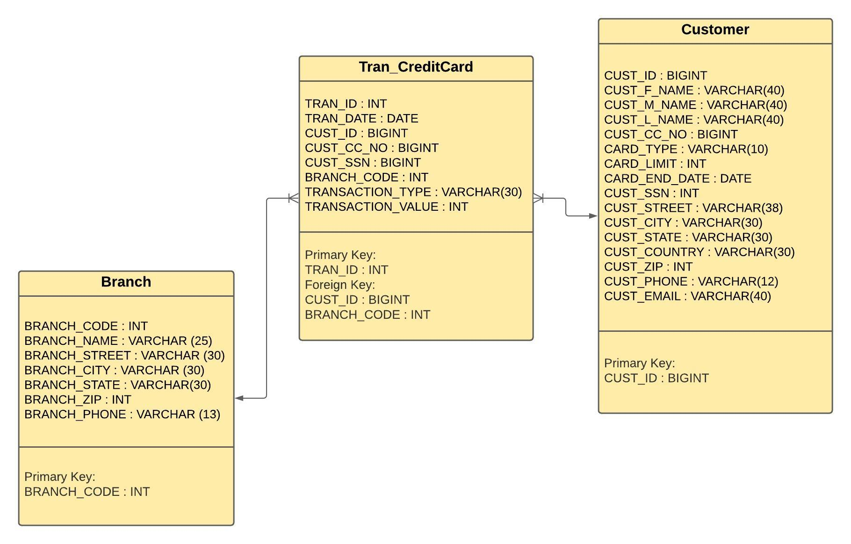
Data Warehouse Schema

Slide 5
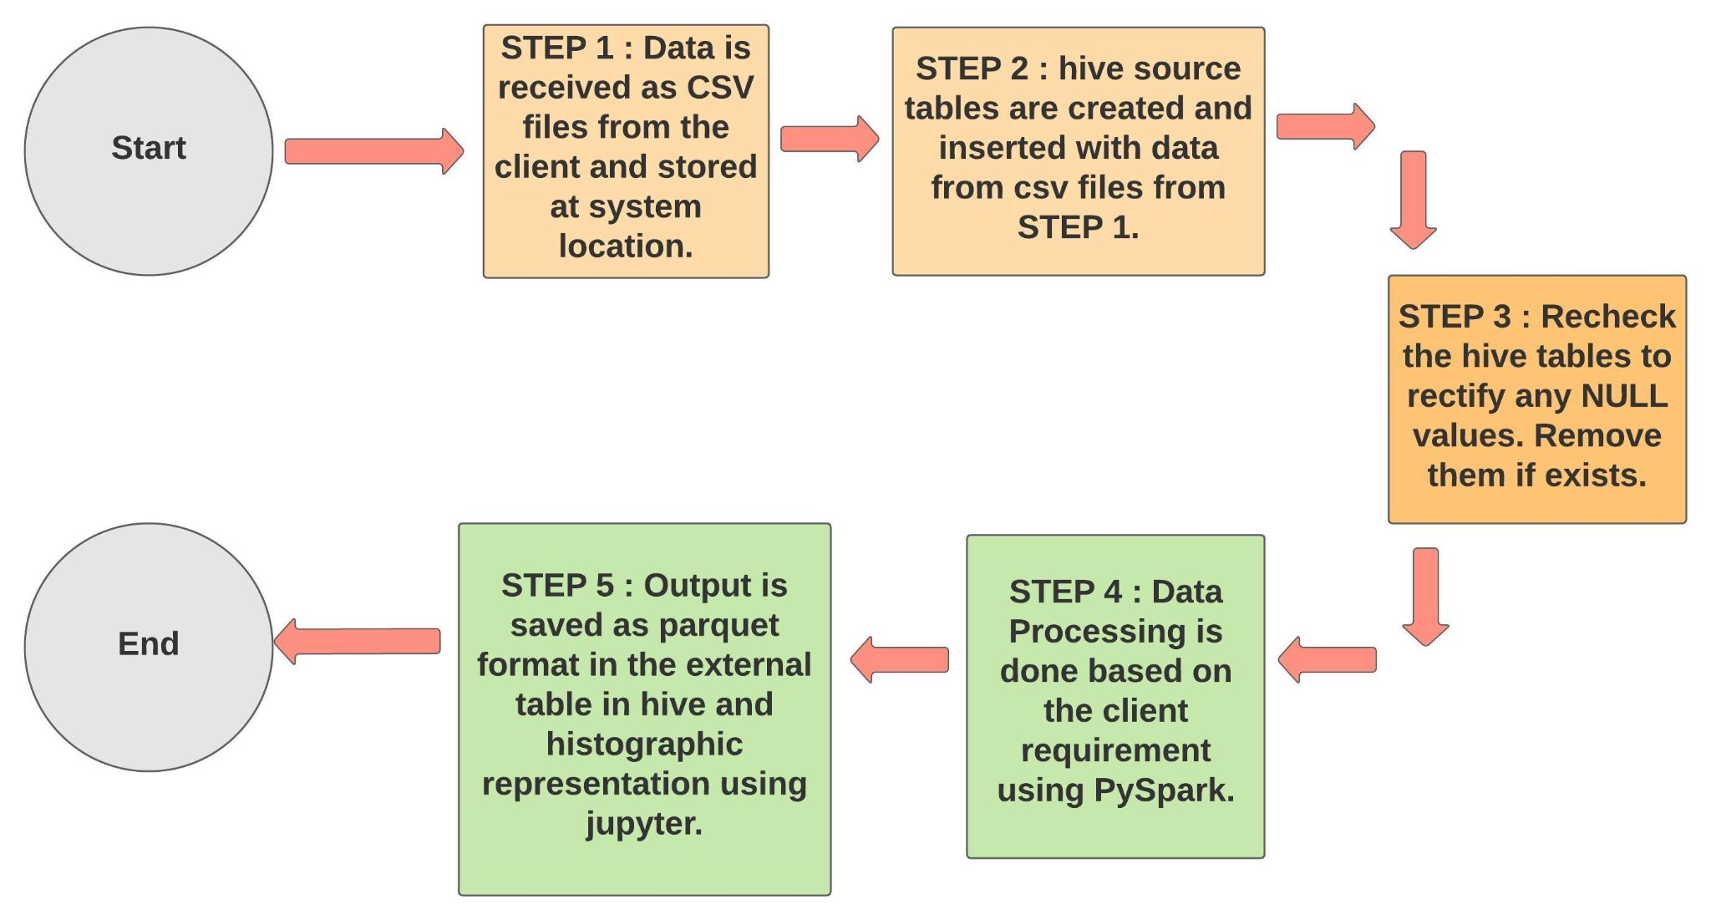
Project Flow

Slide 6



Technical Requirements
Hadoop Distributed File System (HDFS)
HIVE
PySpark

Slide 7
Advantage of Technologies
HDFS:
Horizontal Scalability
Distributed Computing
It can store large amounts of information.
Data replication to avoid data loss.
Project Use: Created directory to store the output as parquet file.

Slide 8
HIVE:
Uses Hive Query Language, which is similar to SQL.
Partition feature that enhances performance
Takes very less time to write Hive query in comparison to MapReduce code.
Project Use: To create internal and external tables.

Slide 9
PySpark:
In-Memory Computation in Spark.
Fault Tolerance in Spark.
Swift Processing as it is much faster than Spark.
Project Use: To partition the table and store the output in external table in hive.

Slide 10
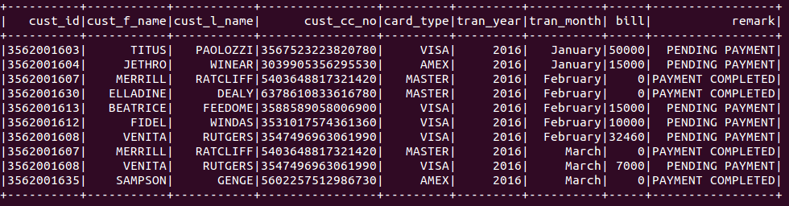
Outcome of the project
Monthly and Yearly credit card transaction report of the customer

Slide 11
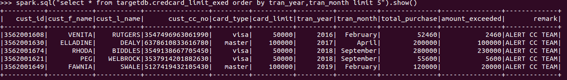
Customers exceeding the card limit

Slide 12
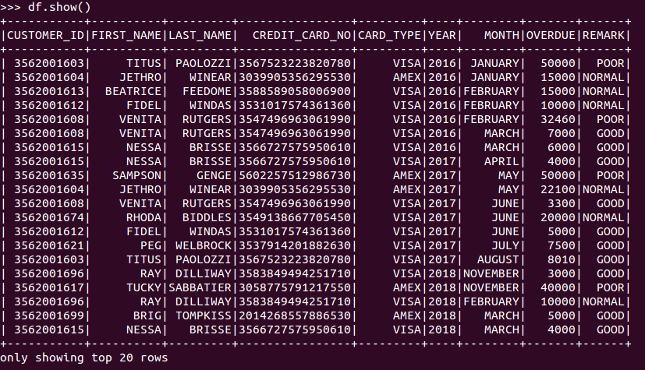
Categorizing customers based on their transactions and overdue

Slide 13
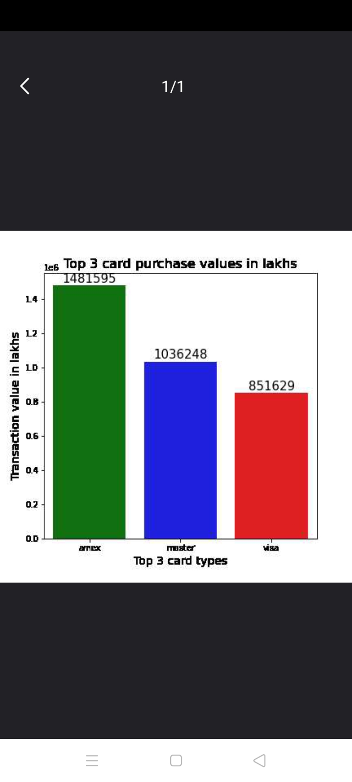
Histographic representation of the top three popular credit cards.

Slide 14
Project Analysis
“AMEX” has the highest total purchase value among all the available credit cards.
Each card occupies the following percentage
AMEX=>44%
Master Card=>31%
Visa=>25%
Types of customers
24 => GOOD
13 =>NORMAL
6=>POOR

Slide 15
Conclusion
The project requirements are to analyze the customer’s data periodically, report the issues and check the card trends. This was achieved in very less time because of PySpark and hive.
Hive tremendously reduces the time to create tables and databases and manage data from hdfs. PySpark has gone one step further in performing in-memory processing and reduce the execution time.

Slide 16


